Slide 1
Kentucky County Sheriff’s
Association Conference
Bookkeeper Training
September 2021
Department for Local Government
Office of Financial Management & Administration

Slide 2
Counties Branch Your Local Gov. Advisor
Tom Dobson
Buffalo Trace
KIPDA
Lincoln Trail
Northern KY

Slide 3
Counties Branch Your Local Gov. Advisor
Jaarad Taylor
Big Sandy
Bluegrass
FIVCO
Gateway
KY River

Slide 4
Counties Branch Your Local Gov. Advisor
Lisa Dale
Barren River
Cumberland Valley
Lake Cumberland

Slide 5
Counties Branch Your Local Gov. Advisor
Will Summersett
Green River
Pennyrile
Purchase

Slide 6
Counties Branch Your Local Gov. Advisor
Wendy Thompson
County Official’s Training Program

Slide 7
Budget Process
October / November
Letter from State Local Finance Officer
Reminder to begin preparing budget
The Official Fee Office Budget Form
Fee Office Budget Forms on the Website
www.kydlgweb.ky.gov
Consumer Price Index estimate –
No longer provided

Slide 8
Budget Schedule
Budget is due to the Fiscal Court By:
January 15th

Slide 9
Approving Fee Office Budget
Approve as a whole
Without spending caps
Approve each line item
Put a spending cap on each line item
Order must state specifics of approval

Slide 10
Setting Maximum Amounts for Fee Offices Deputies and Assistants
KRS 64.530
The Fiscal Courts shall fix annually the maximum amount including fringe benefits which the County Clerk and Sheriff may expend for deputies and assistants.

Slide 11
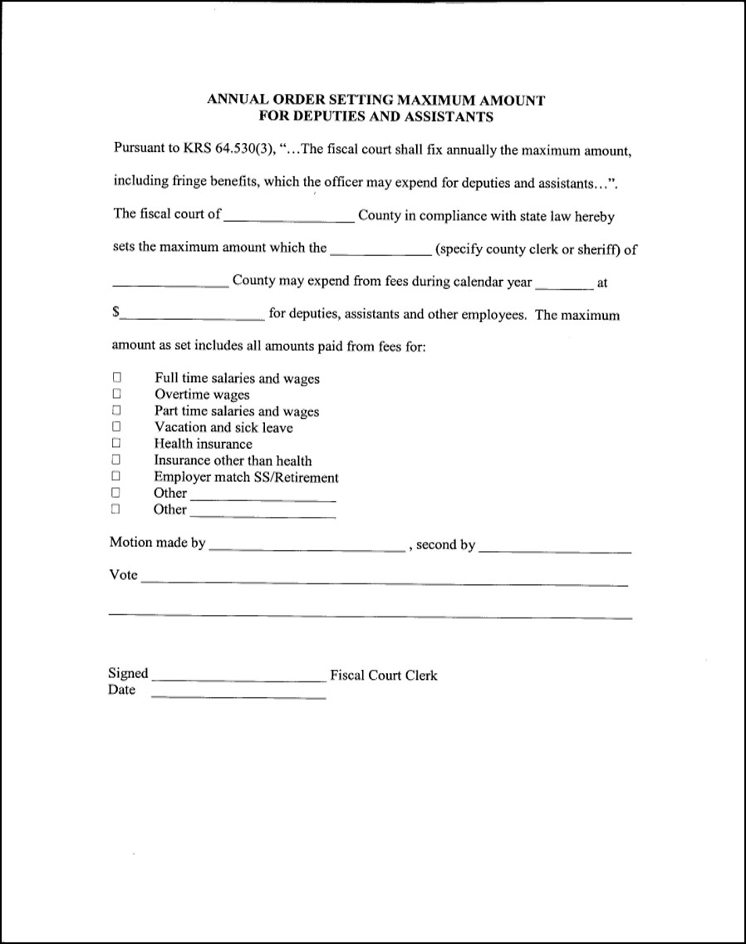

Slide 12
Approving Fee Office Budgets
Amount budgeted to receive from the Fiscal Court on line 11
If the Fiscal Court pays for an item out of the Fiscal Court budget, the same item should not be listed in line 11

Slide 13
Sheriff’s Budget

Slide 14
Fee Official Support
Fiscal Courts may support County Sherriff’s expenses through the payments of claims presented to the Fiscal Court and paid from a properly budgeted line item in the county budget.
Lump Sum Payments (i.e. prior year excess fee reimbursement to the fee office) are prohibited.
KRS 64.710

Slide 15
Handling Public Funds
All accounting systems must comply with the cash basis of accounting
Pre-numbered three-part receipt should be issued for all receipts. – KRS 64.840
Bonding of all officials/employees who handle public fund for an amount covering the maximum amount they have in their control at one time.

Slide 16
Handling Public Funds
Advertisements for completive bids prior to purchases exceeding $20,000 – KRS 424.260
No bonuses, no payments for goods or services, and no contributions. – Section 3
Annual financial statement prepared – KRS 424.220
Books of original entry for receipts and expenditures and or utilization of daily cash check-out sheets-KRS 68.210

Slide 17
Handling Public Funds
Daily deposits intact into federally insured banking institution. – KRS 68.210
All investments must follow the Investment Policy adopted by the agency. – KRS 66.480
Personal fund kept separate from public – KRS 64.850
Monthly bank reconciliation – KRS 68.210

Slide 18
Handling Public Funds
Disbursement by check only – KRS 68.210
Fixed Assets documentation (inventory)
Preparation of an annual budge showing estimated receipts and expenditures – KRS 68.210
Interest Bearing Accounts

Slide 19
Sheriff Fee Accounting
Prescribed by the State Local Officer
Cash Basis of Accounting
Requires budget approval by the Fiscal Court
Quarterly Financial Statement submitted to the State Local Finance Officer.

Slide 20
Sheriff Fee Accounting
Books of Account
Three-part receipts
Daily Cash Checkout Sheet
Receipt Journal
Check Distribution Register
Expenditure Ledger
Quarterly Financial Statement

Slide 21
Receipt
Source document of record
Three-part
Pre-numbered
Original given to payor
Copy attached to daily checkout
Copy filed numerically

Slide 22
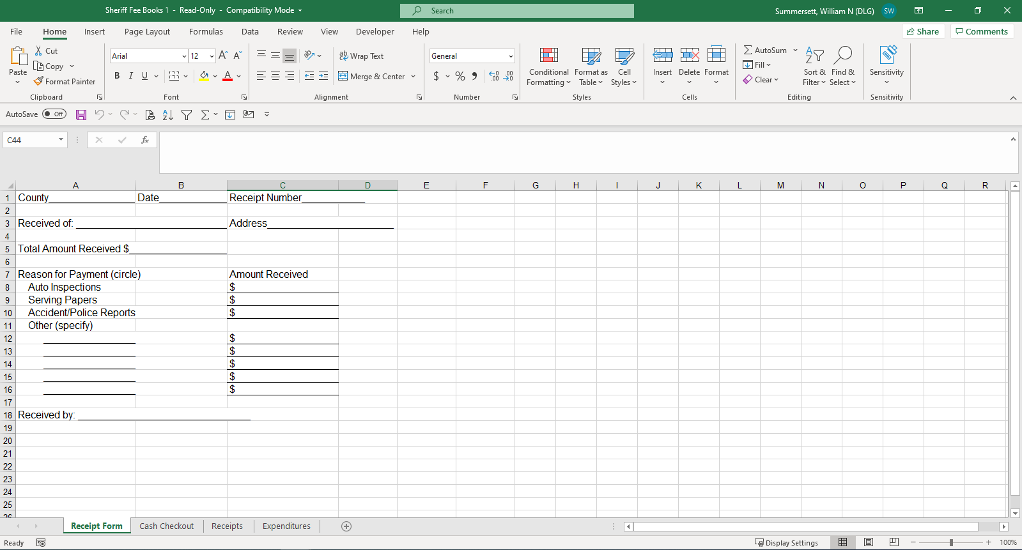

Slide 23
Daily Cash Checkout Sheet
Daily Summary of activity
Broken down into various categories
Receipt form totals are posted here
Daily deposits should equal the sum total of all daily cash checkout sheets.

Slide 24
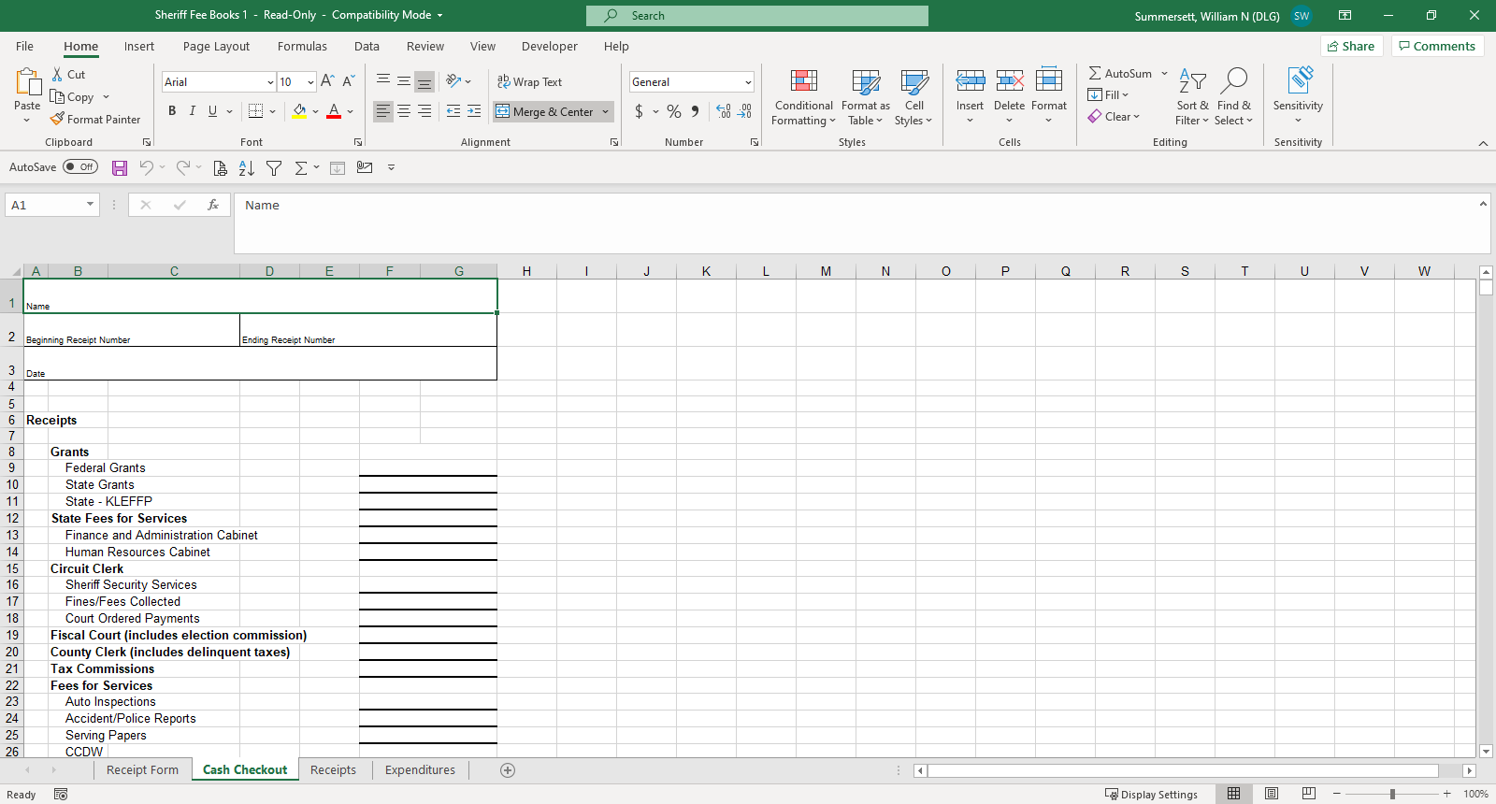

Slide 25
Receipts Journal
Records receipts by category
Daily recording of cash checkouts sheet data is posted here
Journal information is transferred to part 2 of the Quarterly Financial Statement

Slide 26
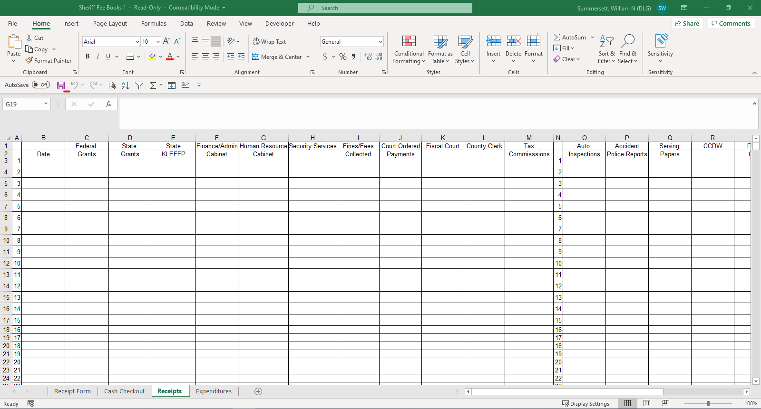
Expenditure Ledger

Slide 27
Expenditure Ledger
Chronological posting from check distribution register (checkbook register)
Breaks down expenditures by category
Expenditure Ledger information is transferred to part 3 of the Quarterly Financial Statement

Slide 28
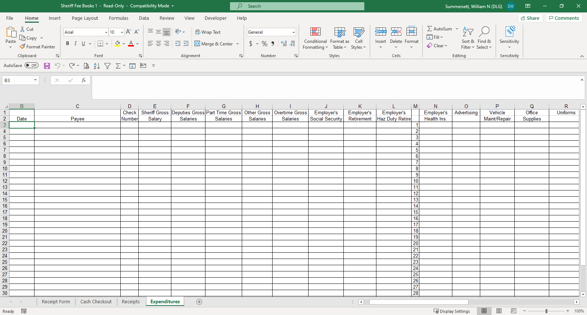

Slide 29
Budget & Quarterly Report

Slide 30
Quarterly Financial Statement
Cumulative Report
Due 30th of the month following quarter
Four Parts
Summary & Reconciliation
Receipts
Disbursements
Liabilities
Long Term Debt
Example: Vehicle/Purchase
Short Term Debt
Example: Fee Advancement

Slide 31
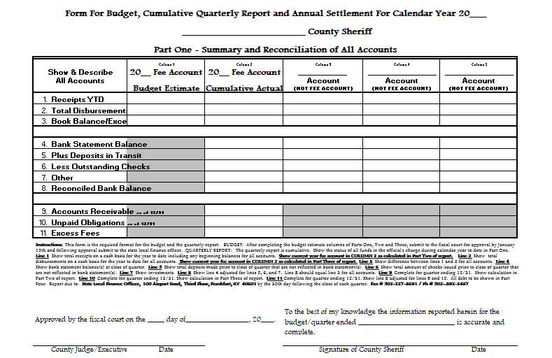

Slide 32
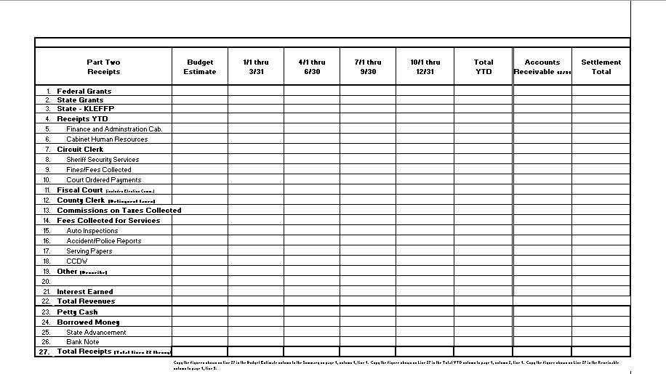

Slide 33
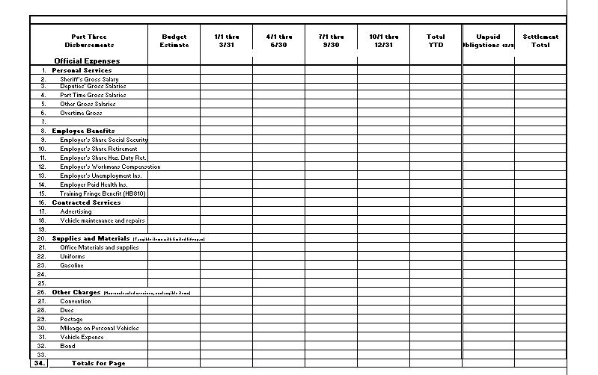

Slide 34
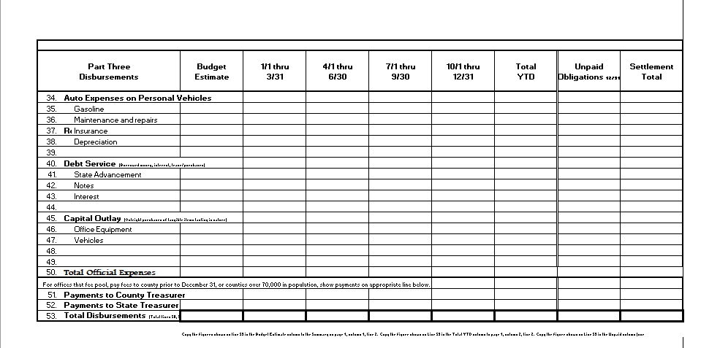

Slide 35
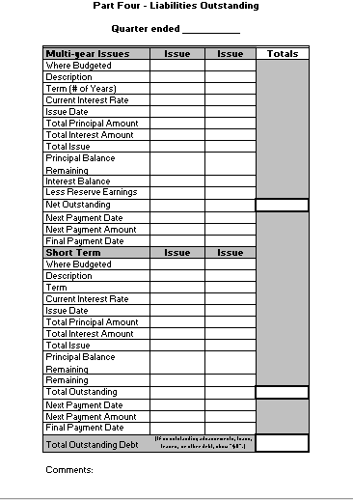

Slide 36
Your Budget / Quarterly Report
What Do We Look For ???

Slide 37
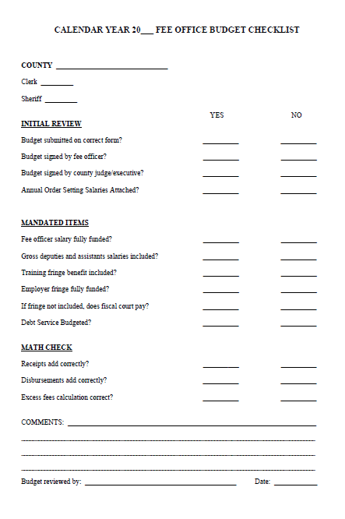

Slide 38
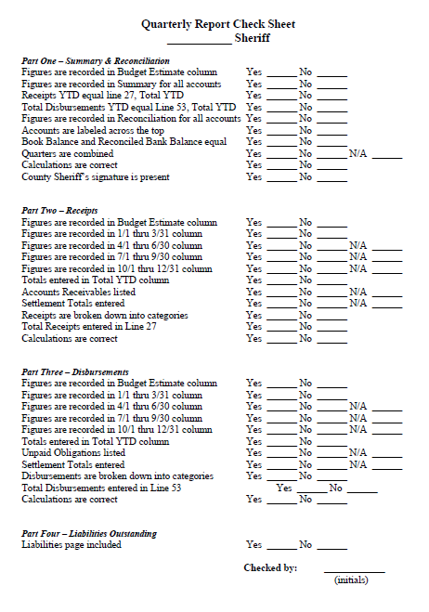

Slide 39
Common Errors
Fee account is “force balance” to incorrect data
Account bank reconciliation not shown
Book Balance and Reconciled Bank Balance do not agree
Year-to-Date Column not completed and totaled
Part Four, Liabilities Outstanding sheet is missing or incomplete

Slide 40
Common Errors
Report not signed by the fee official
Basic math errors
Figures not recorded in the budget estimate section of receipts and disbursements
Report not shown as cumulative amount on Part One, column 2

Slide 41
Check Sheets
Both the Budget and Quarterly Report Check Sheets are available on our website
www.kydlgweb.ky.gov

Slide 42
Questions
Department for Local Government
Office of Financial Management & Administration
100 Airport Road
Frankfort, KY 40601
www.kydlgweb.ky.gov
1-800-346-5606
Fax: 502-573-3712

